Slide 1
September in Primary school Barilović
Teachers plan lessons and workshops on EDC/HR for the Annual plan and program of school
The Action plan is included in School Curriculum
Presentation of the Action Plan and the objectives of the project to Councils of the school (Teachers Council, Parents Council and School Bord)
Establish the Team for Human Rights (Ivana Banjavčić, Josip Novosel, Vesna Car and new member Dejana Kirinčić, school pedagogue)

Slide 2
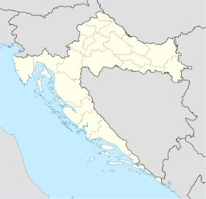
Primary school Barilović and old town Barilović
Croatian flag and coat of arms
Barilović - coat of arms

Slide 3
October in Primary school Barilović
Parents Council discussed the possibilities of better cooperation between parents and school staff
Ideas are written down on paper in the form of fish so we know in which direction we want to „swim”
Parents have launched an initiative for better labeling of road near the school and soon follow the result: Setting new road signs, put new paint on the pedestrian crossing and traffic sign for the school. Speed bumps are not set.
Parents' Council will meet again in November

Slide 4
