Slide 1
February in Primary school Barilović
We presented the project Human Rights in action on the website of our school http://os-barilovic.skole.hr/ljudska_prava#mod_news
We celebrated Safer Internet Day (February 7) and International Mother Language Day (February 21)
Europe Direct prepared a presentation for our 8th grade students. They talked about the EU, its origin, history, institutions… In the end they played a small quiz and students showed how well are acquainted with the European Union!

Slide 2
International Mother Language Day
The students wrote short stories, poems and anecdotes using homeland dictionary and words used in their families. According to past experiences, family members are happy to help children when it comes to writing an essay or songs in their native language. They created a line of words and word clouds respecting pronunciation and writing and similarity to the words of other languages. This is only an introduction to the teaching project that has a goal of collecting student works in a digital songbook using indigenous motifs Barilović region, and thus mark Days of languages which last until March 17. Our wish is to involve parents, writers, radio hosts ...
We found that each of us is a responsible individual who transmitts the mother tongue in the legacy of other generations.

Slide 3
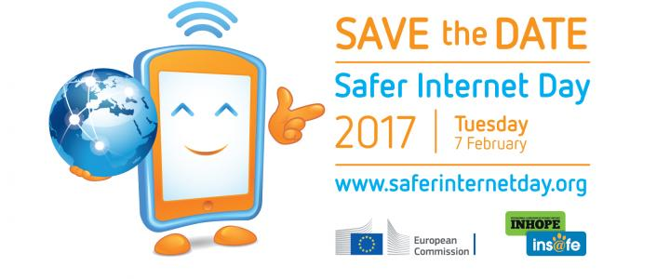
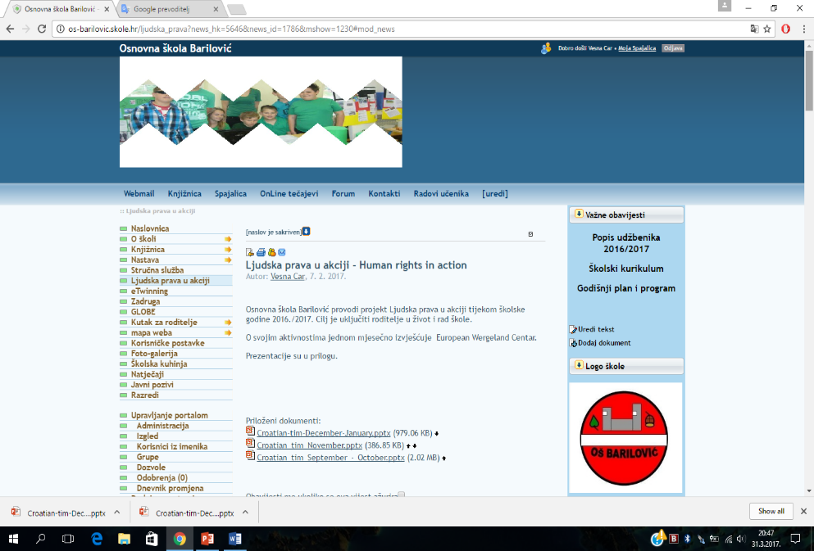
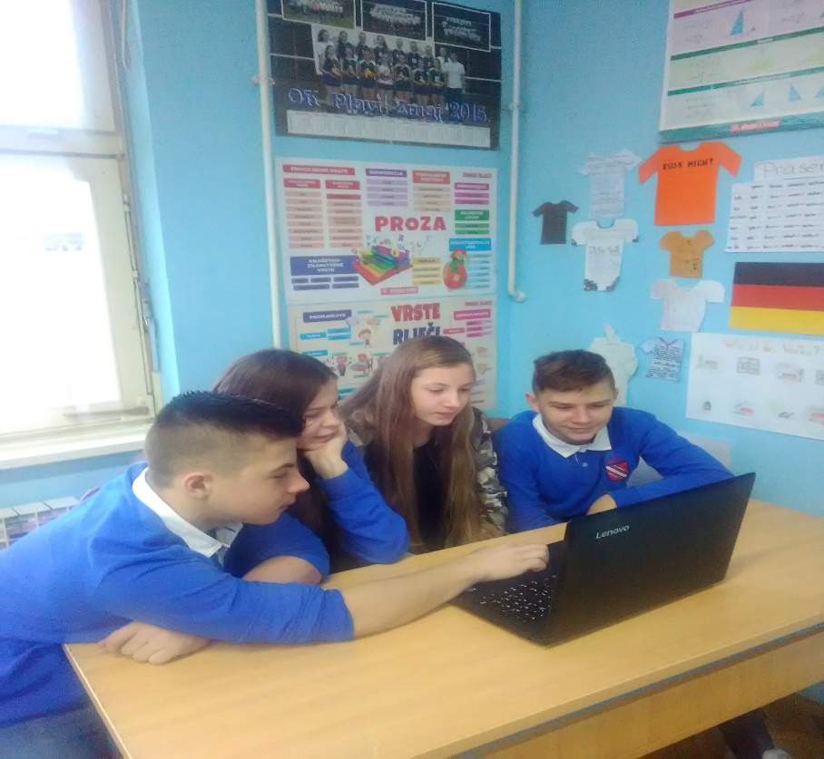
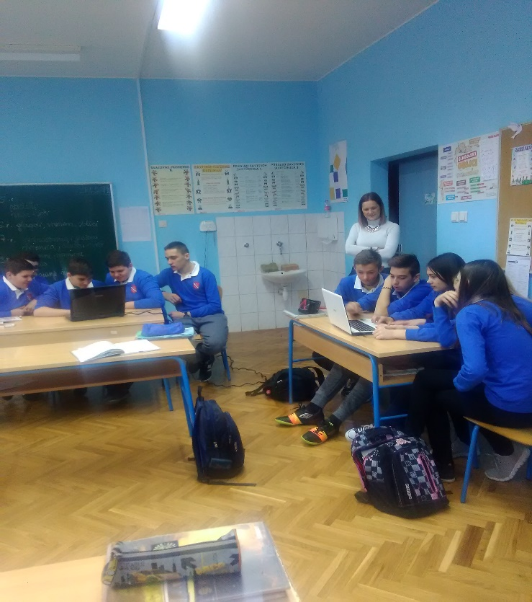
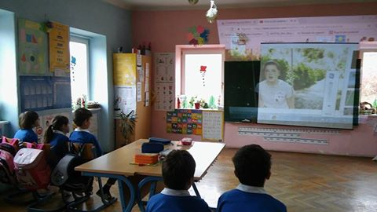

Slide 4
March in Primary school Barilović
Promoting World Down Syndrome Day (March 21) The symbol of this day are colorful socks because people with Down syndrome have problem with merging pairs. All of us were in striped socks. The feeling was wonderful!
World Water Day(March 22) was marked by a walk along the river Korana. We observed and identified the plants and animals that live in the Korana. The 5th grade students measured water temperature and air humidity and saturation of water with oxygen. Unfortunately under the bridge we saw a dead beaver which the water is brought to the waterfall.

Slide 5
