Slide 1
December in Primary school Barilović
We launched four international project with the help of the eTwinning platform where our partner schools are from European countries. Projects are related on EDC/HR education:
Christmas cards exchange Pre-school students with their parent's made greeting cards and send them to partner schools. They are looking forward to receive cards from partner schools.
I'm different I'm successful Through this project we will teach students how much diversity enriches us. We want to showcase the richness and diversity of Europe as well as the diversity of every school and every pupil
Recipe Book The emphasis will be on getting to know a specific part of the Croatian and Portuguese culture - traditional food, with the use of ICT tools, encourage students to improve their skills, to arouse their cultural curiosity and their awareness for cultural difference. The project will be realized in cooperation with parents.
Math in the supermarket Goals: - Make a connection between the math concepts learnt and our daily lives. - Learn how to convert money into different currencies. - Realize of the importance of know how to convert currencies when travelling. - Compare and know how supermarkets are and work in other countries. - Discuss the concept of globalization. - Reflect and debate the causes of the difference of price in the same item in different countries.
Students and teachers are preparing for Christmas events and organized workshops in which students together with their parents created Advent wreaths and ornaments for a Christmas tree
We celebrated International International Day of Disabled Persons (December 3).

Slide 2
Inclusive day
On December 5 we held a workshop for students and parents. The workshop which was attended by a student with disabilities as well as other students commemorate the International Day of Disabled Persons. Through the workshop we encourage students and parents to talk about children's rights, the benefits of inclusive education, stereotypes and prejudices. The participants were acquainted with the Convention on the Rights of the Child, and we tried to encourage them to reflect on their own role in the acceptance of diversity.
In a pleasant working atmosphere, students and parents have created posters with messages of support inclusive education. (Dejana Kirinčić)

Slide 3
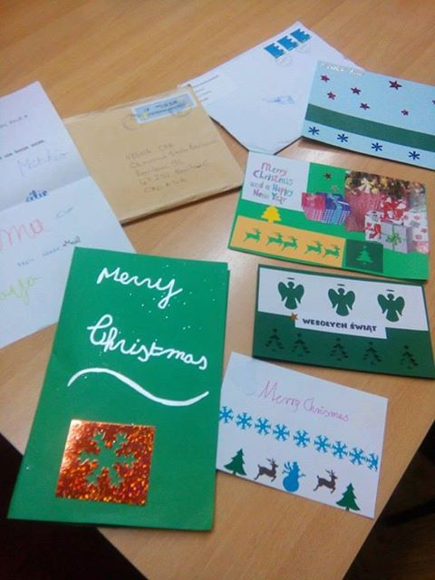
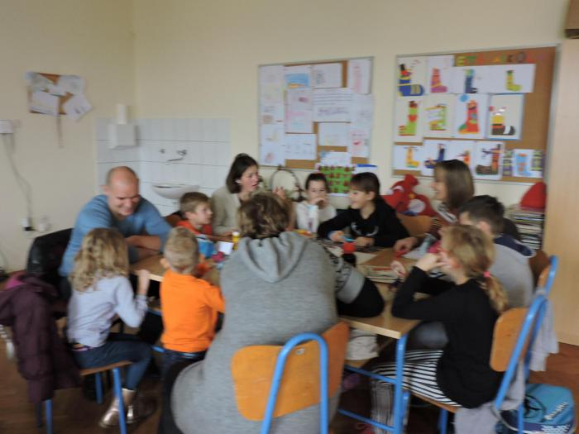
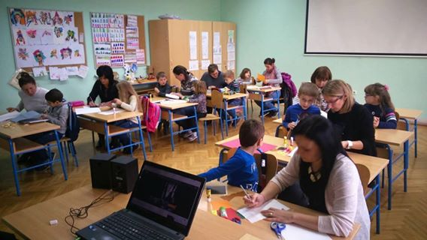
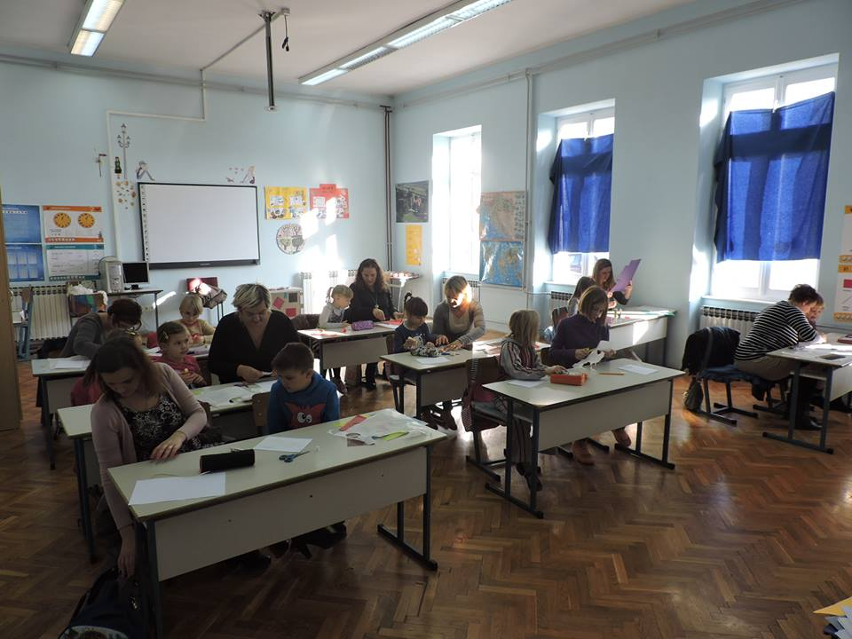
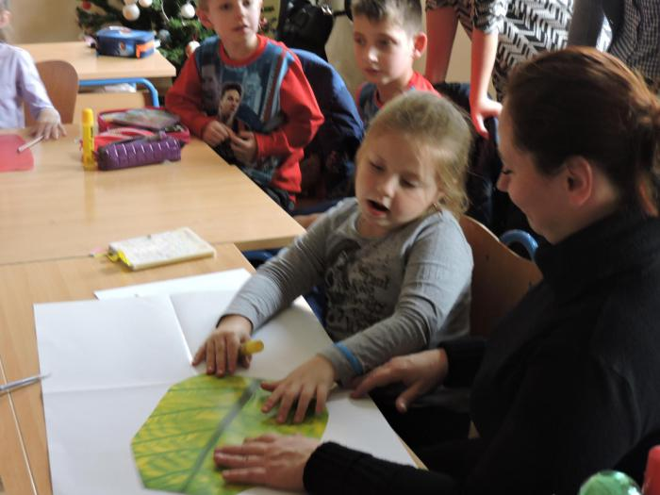
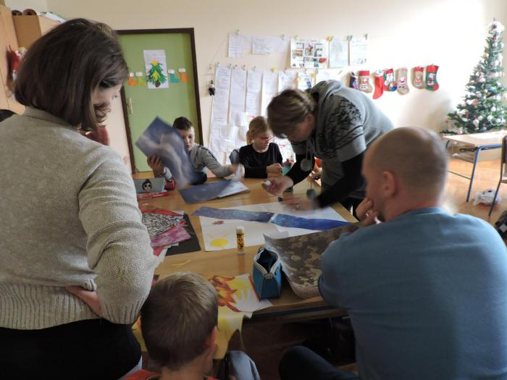
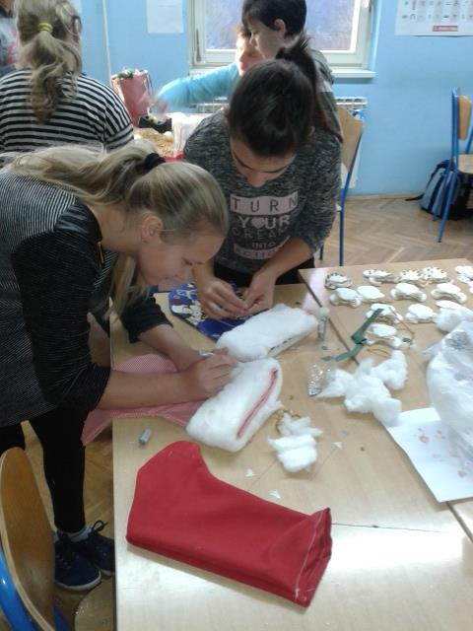
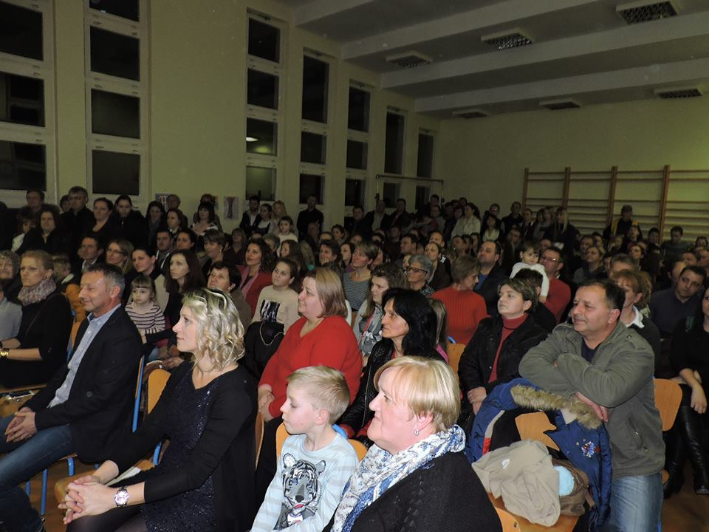
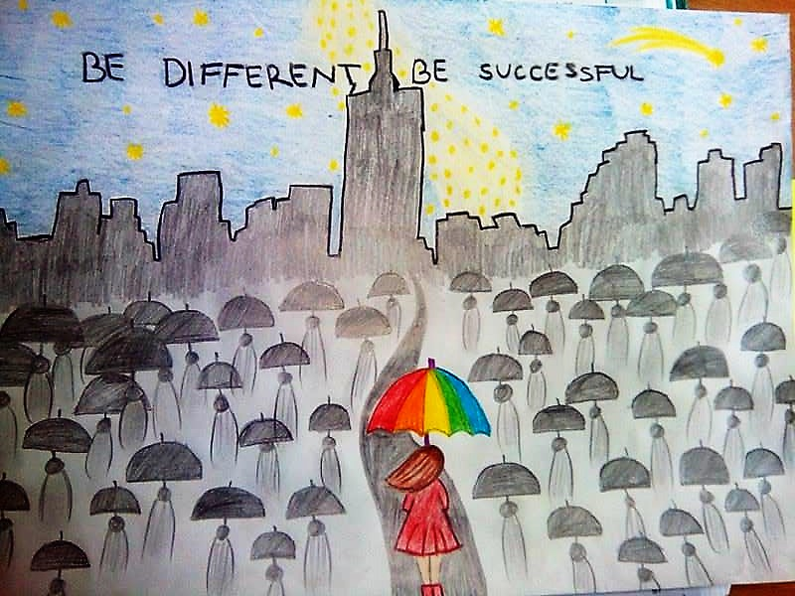
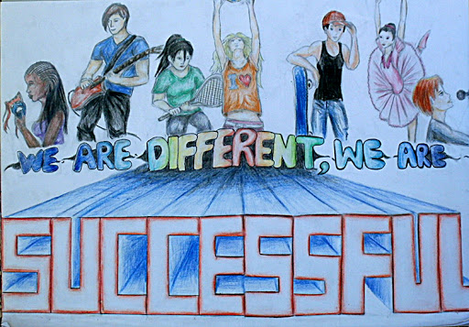

Slide 4
January in Primary school Barilović
The Team for Human Rights (Vesna and Dejana) visited teachers lessons and workshops on EDC/HR
SWOT analysis conducted by the Team for Human Rights (spent on all parent meetings ) is presented to the Council of teachers and School Board
The headmistress Vesna Car presented the project Human Rights in action at the local radio and television
We celebrated International Day of hugs (January 21)

Slide 5
