Slide 1
April in Primary school Barilović
We had realized the exchange of experience and examples of good practice with other schools through some projects:
We had a joint meeting with teachers from Primary school Netretic and Primary school Cetingrad. The aim of the meeting was to plan new activities in the areas of ICT, Ecology and Entrepreneurship. We want to create new curricula so that students can improve their competencies based on lessons and workshops on EDC/HR. This project has been reported to the European Social Fund and we hope to significantly enhance the competences of the teacher. Support has also been provided by parents who will be an important partner in achieving these content.
For the whole school year, we are working on a project with the Primary school heroja Janeza Hribarja from Slovenia. The project carries the name Reading does not know the boundaries. We have co-operated during our stay at the Summer Academy in Cetinje. The project ends with a joint gathering in June. Slovene students come to our school. They will present their work and teachers will cexchange experiences. Carriers of these activities are school librarians from both schools.

Slide 2
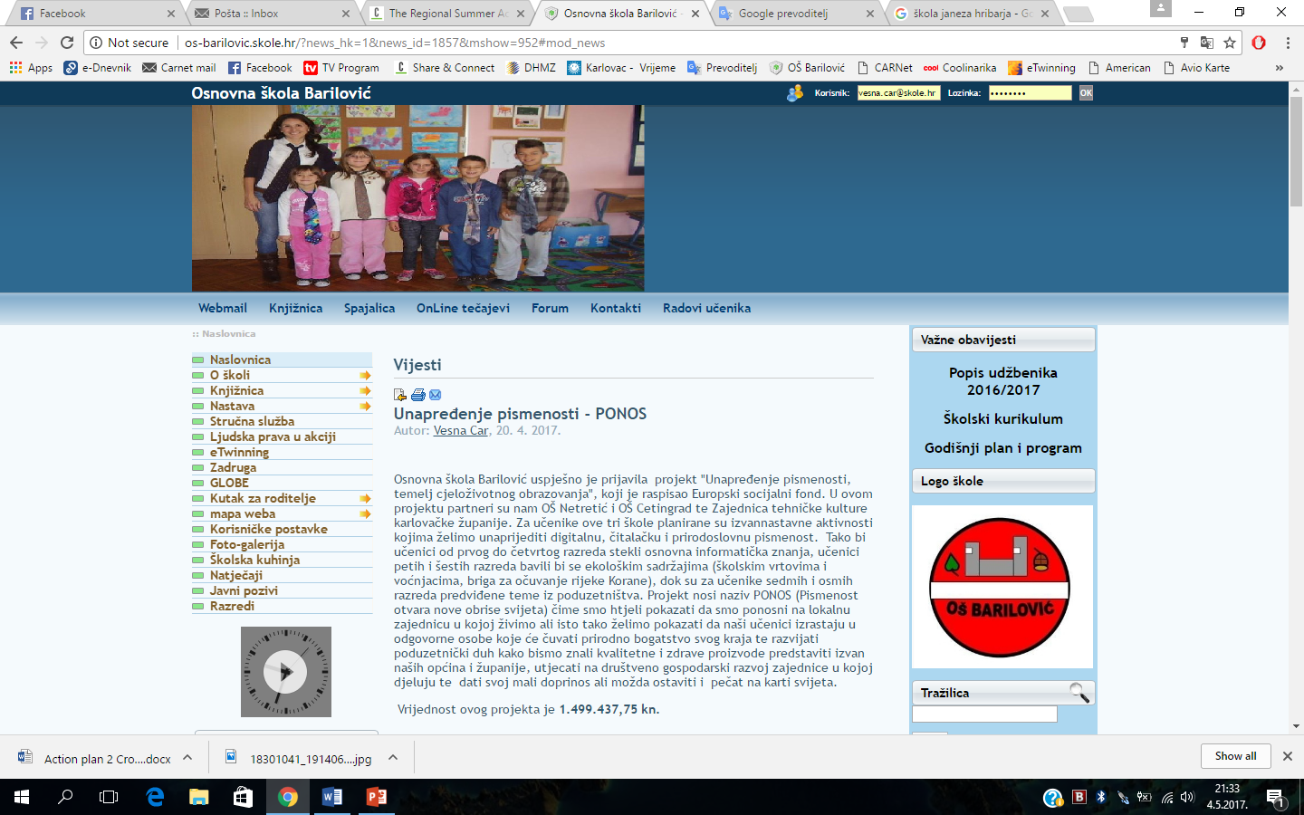
The project was named PONOS (Literacy opens new contours of the world). We wanted to show that we are proud of the local community we live in. Also we want to show that our students grow up in a responsible human beings who will preserve the natural wealth of their land and develop an entrepreneurial spirit in order to produce quality and healthy products presented outside of our municipalities and countrie, affect the socio-economic development of the community in which they operate and give their small contribution. We hope our pupils may also leave a stamp on the map of the world promoting EDC/HR.

Slide 3
May in Primary school Barilović
The project day was organized on May 2nd
We have been partnering with parents through sporting activities and riding bicycles for about ten years now. This year the number of parents was three times higher. We believe that the activities we carried out with the project Human Rights in Action have been strongly contributed to.
All of the above activities are recorded on the school's web site http://os-barilovic.skole.hr/ and school facebook OŠ Barilović

Slide 4
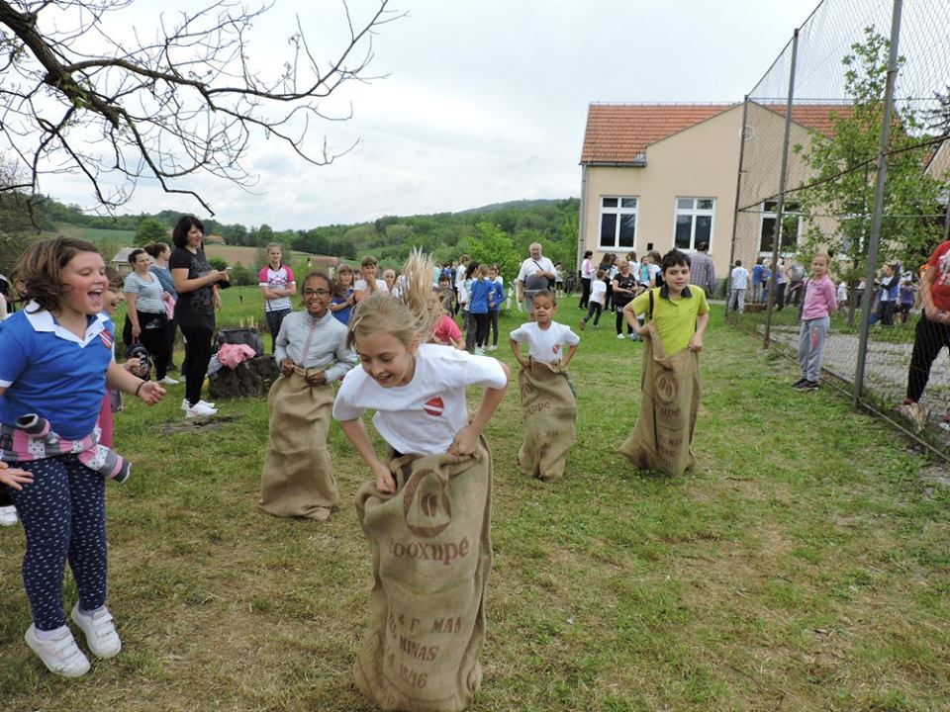
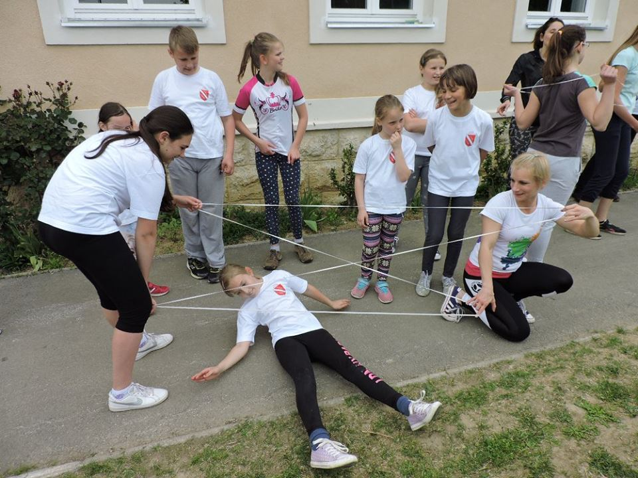
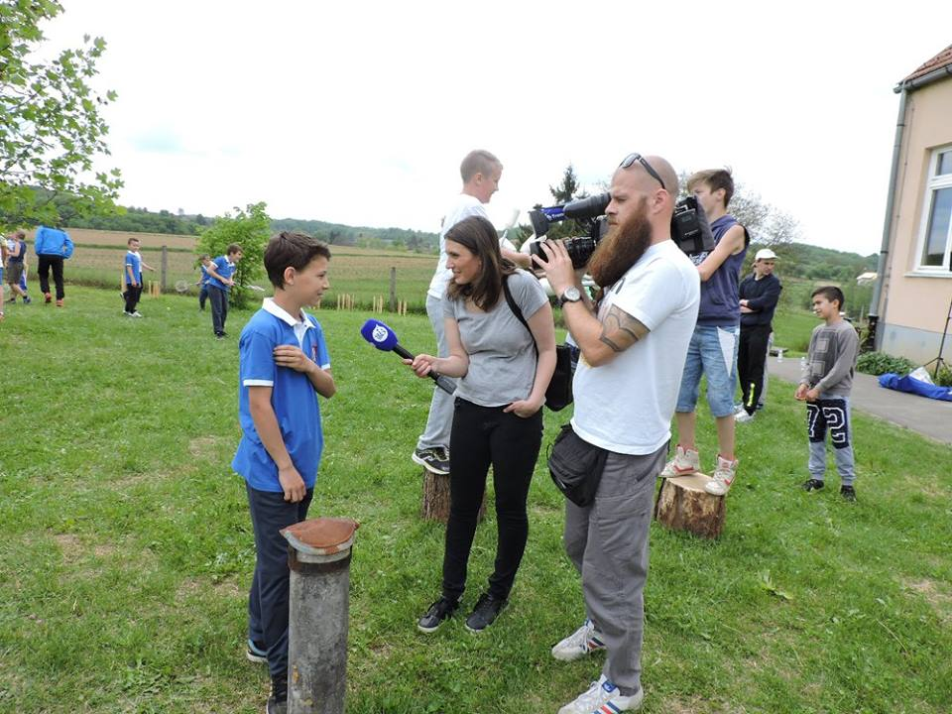
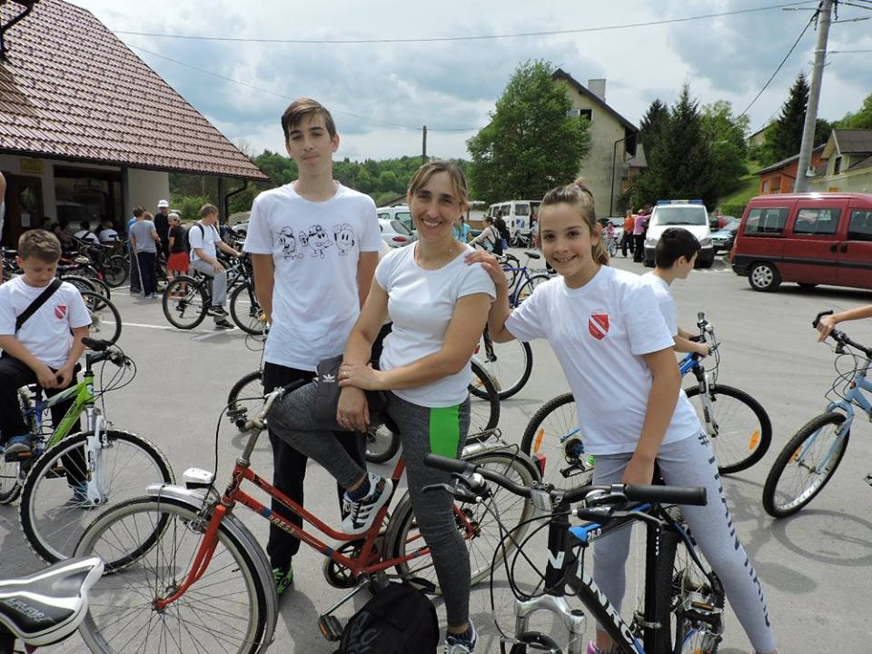
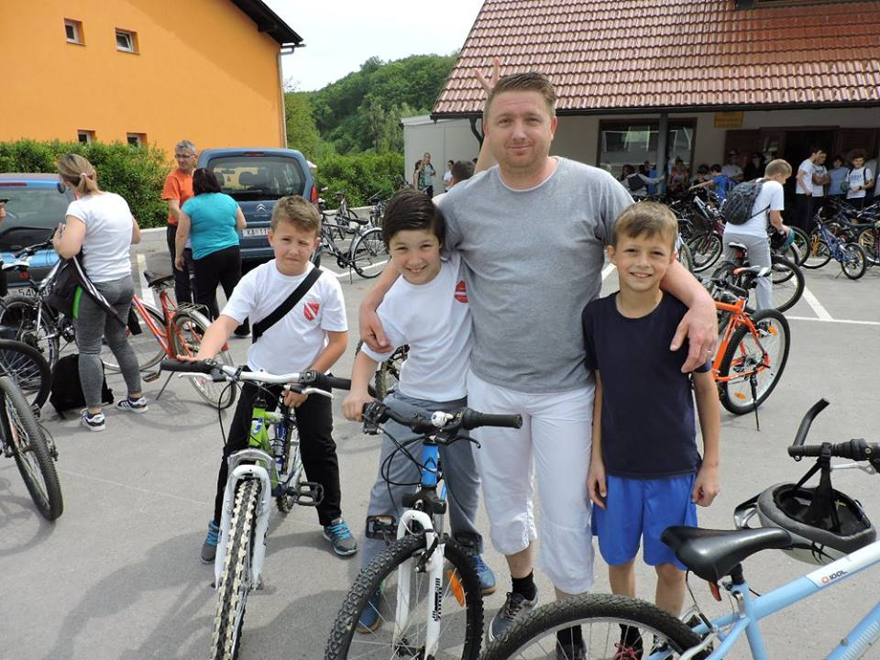
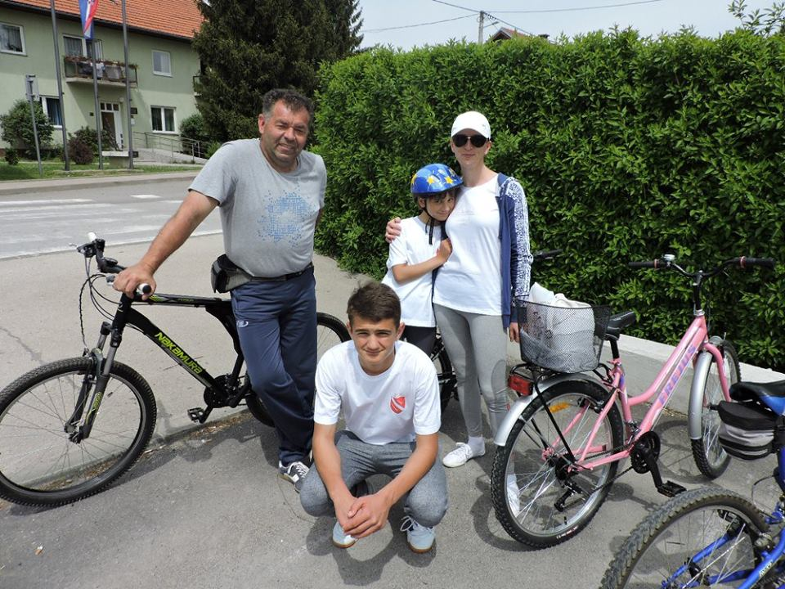
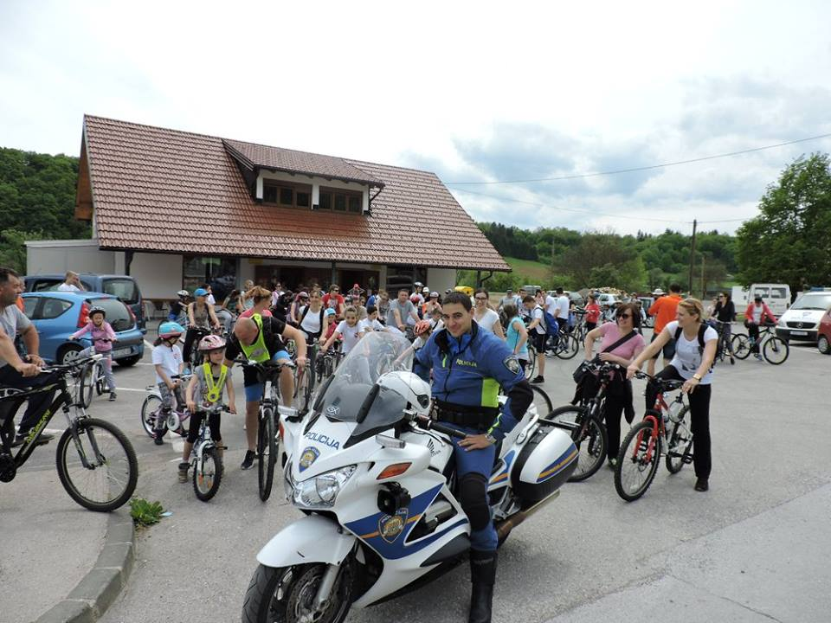
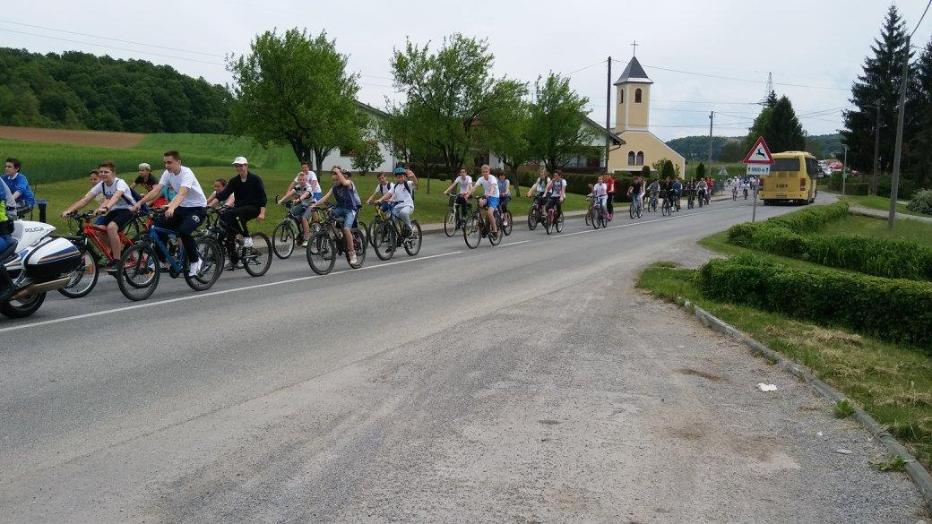
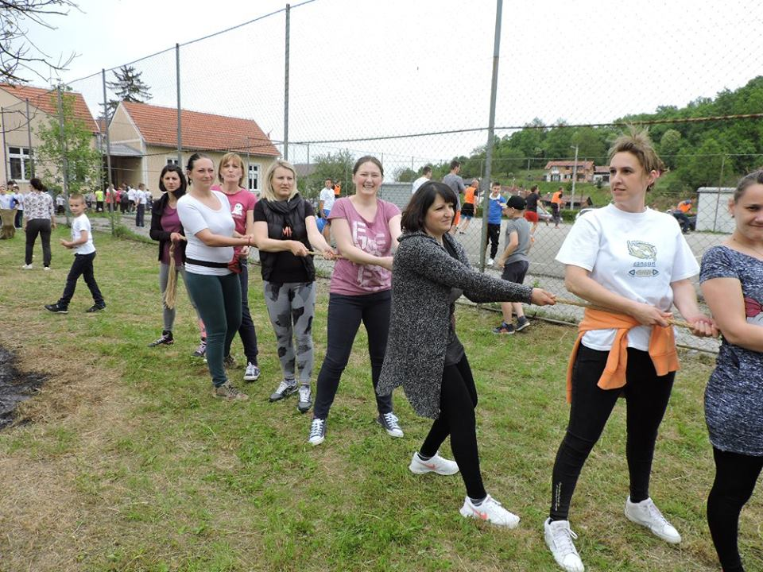
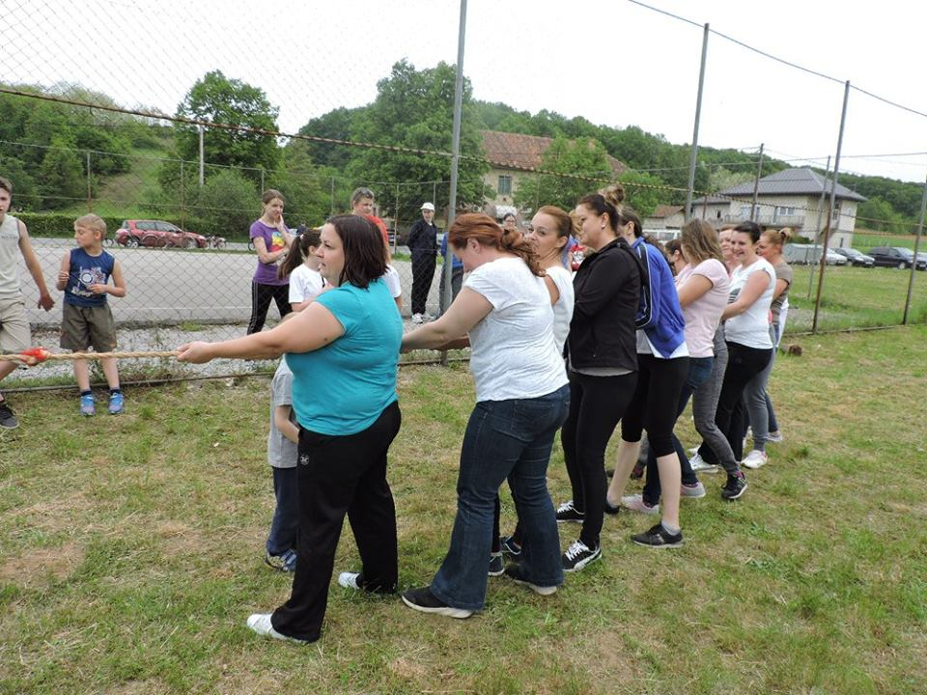
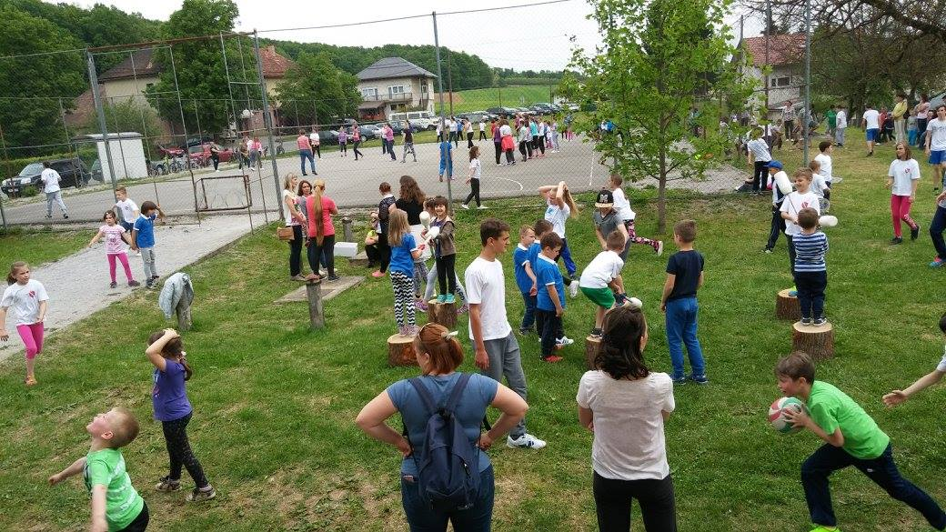

Slide 5
